Slide 1
Commonwealth Veterinary Association
[name]
[position], Commonwealth Veterinary Association

Slide 2
Presentation outline
CVA background, mission
CVA work priorities
Partnerships for delivery
Going forward

Slide 3
Commonwealth Veterinary Association
Founded in 1967
Not for profit association of 55 countries - 53 commonwealth countries
Membership - the National Veterinary Associations
Associate member countries / international organisations
A charity – registered in India
6 regions, each with a regional coordinator to coordinate and country delegates in each member country
NOT ONE SALARIED STAFF MEMBER – Voluntary

Slide 4
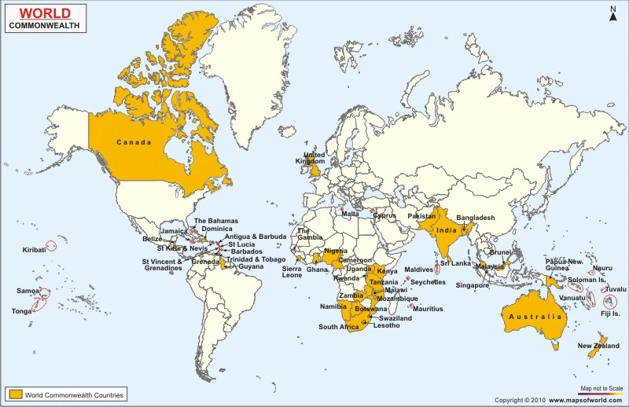
Our regions
UK-Mediterranean
Asia
Caribbean
West Africa
East, Central and Southern Africa
Australasia/Oceania

Slide 5
Our Team
President - Dr Sarah Eytle (Jamaica)
Secretary - Dr Jeff Cave (Australia)
Treasurer - Dr Dianne Philips (Australia)
Program Director - to be confirmed
Immediate Past President - Dr Olatunji Nasir (Nigeria)
Executive Director - Dr Abdul Rahman (India)
Communications Coordinator – Dr Joshua Ngwisha (Zambia)

Slide 6
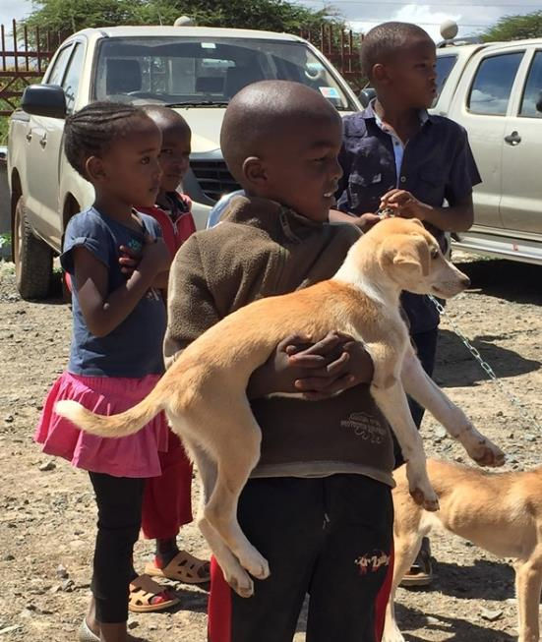
Our Mission
‘to promote the veterinary profession within the Commonwealth by encouraging the highest professional standards of education, ethics and service, in order to advance animal health, productivity and welfare to improve the quality of life of all its peoples’.
Kenyan children at a rabies clinic on World Veterinary Day

Slide 7
CVA Work Priorities
Continuing professional development
CVA study fund
Animal Welfare Training by Open Philanthropy
Training programs, workshops, conferences
CVA donated veterinary texts program
On-line CPD modules

Slide 8
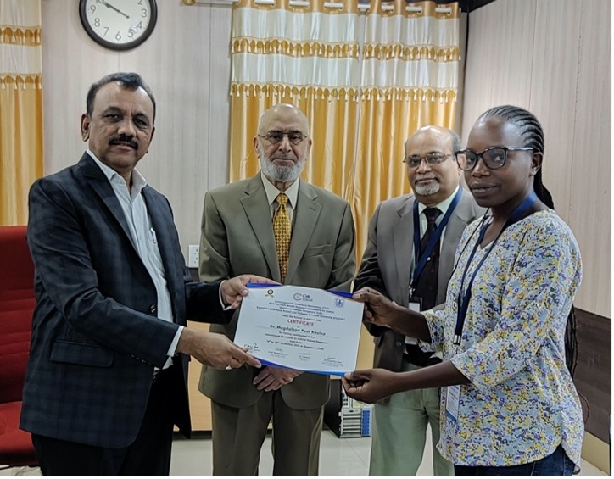
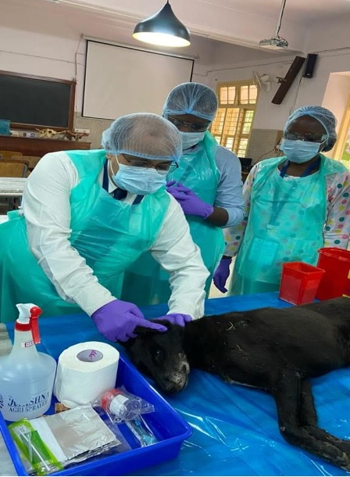
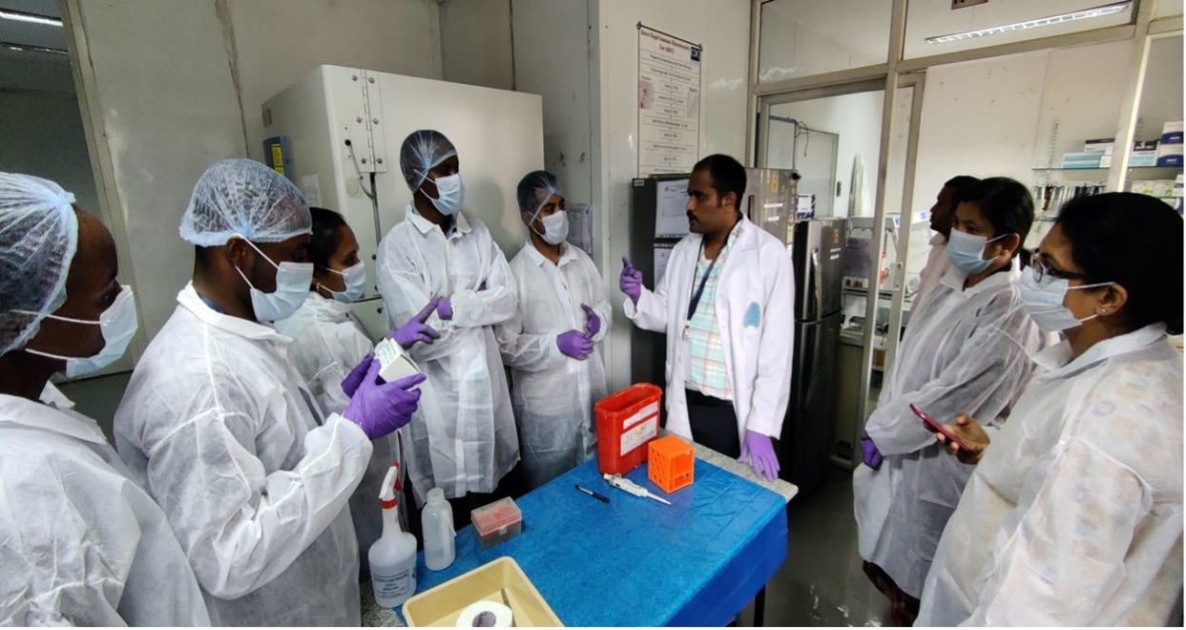
CVA Study Fund
Usually 2-4 weeks
Funds to cover airfares and some accommodation
Accommodation and travel within country usually sponsored by collaborating vet practices, university, etc.
Distribution of certificate to Dr.Kesseka from Tanzania
Demonstration of direct fluorescent assay
Demonstration of collection of brain sample based on Occipital Foramen approach

Slide 9
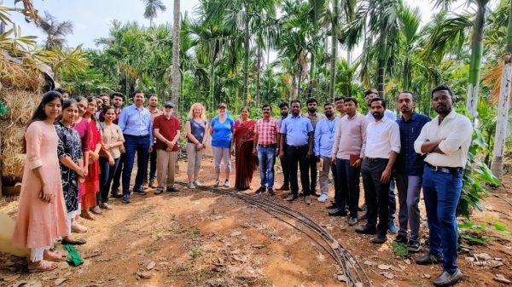
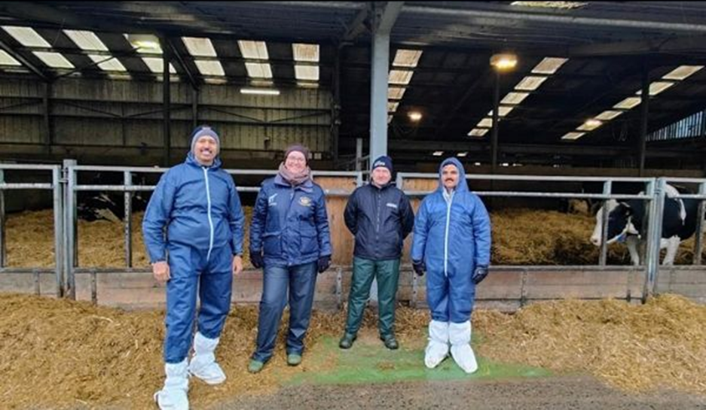
Animal Welfare Training by Open Philanthropy
International workshop on animal welfare research with the keynote address given by Dr Cathy Dwyer, Director JMICAWE, The Royal (Dick) School of Veterinary Studies, University of Edinburgh, UK
Dr Vivek M Patil and Dr Mahadevappa D Gouri at the Jeanne Marchig International Centre for Animal Welfare Education (JMICAWE), The Royal (Dick) School of Veterinary Studies, University of Edinburgh

Slide 10
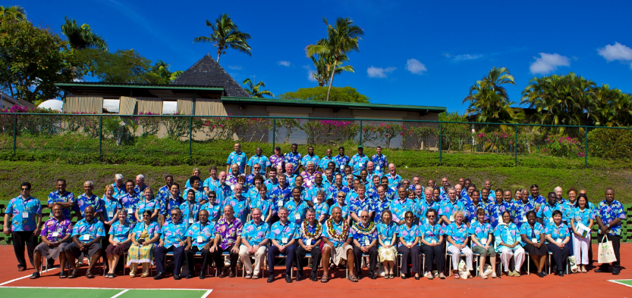
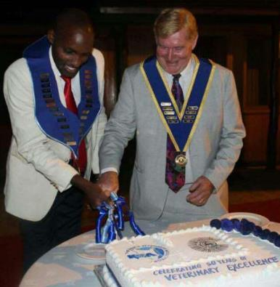
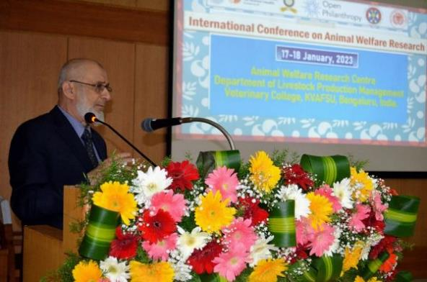
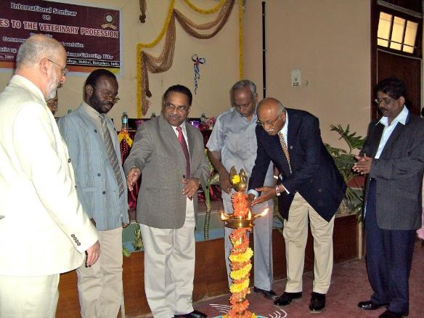
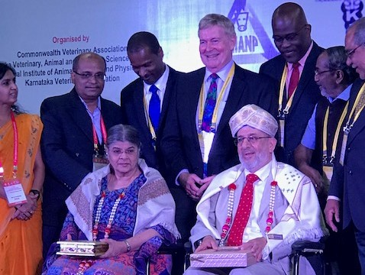
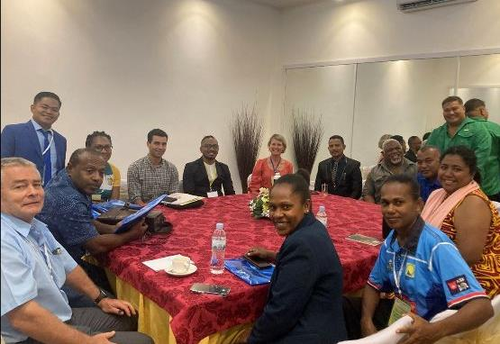
Training programs, workshops, conferences

Slide 11
Donated books
For many years, the CVA has run a voluntary book program
donated veterinary texts are collected, recorded and posted to individual veterinarians and various universities in member countries
Veterinary textbooks ready for postage from the CVA book program

Slide 12
On-line CPD
Working with the WCEA, the CVA education portal has had 9368 members register from 166 different countries. There are more than 600 different CPD modules currently available. Free for vets from developing countries!
In association with Vet Sustain and VetSalus three recipients were funded to complete the on-line course “A Veterinary Approach to Sustainable Food and Farming”.

Slide 13
CVA Work Priorities
Projects
CVA / Karnataka Veterinary, Animal and Fisheries Sciences University (KVAFSU) World Organisation for Animal Health (WOAH) Reference Laboratory for Diagnosis of Rabies
CVA/KVAFSU Animal Welfare Research Centre
Small Project Funding

Slide 14
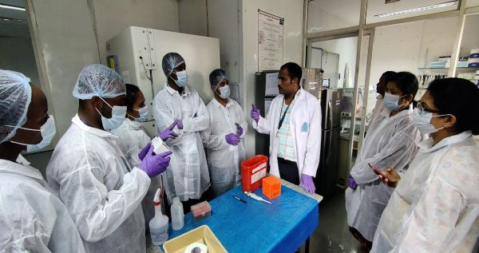
CVA Projects
CVA/KVAFSU WOAH Reference Laboratory for Diagnosis of Rabies
Situated in Bangalore, India with a satellite laboratory in Pondicherry
Training workshop on animal rabies diagnosis

Slide 15
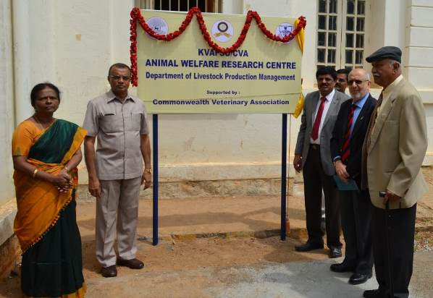
CVA Projects
CVA/KVAFSU Animal Welfare Research Centre
Situated in Bangalore, India with a satellite centre in Pondicherry
The opening of the CVA/KVAFSU Animal Welfare Research Centre in Bangalore

Slide 16
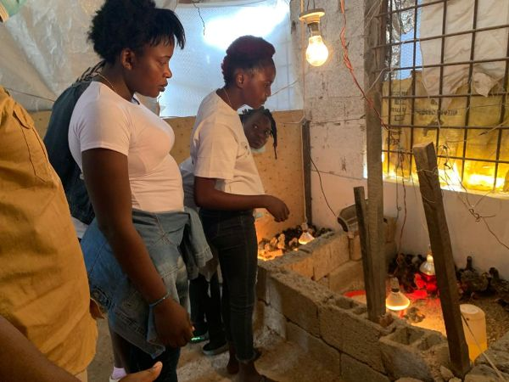
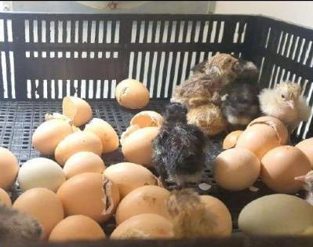
CVA Projects
Small Project Funding - Sustainable poultry production in Zambia

Slide 17
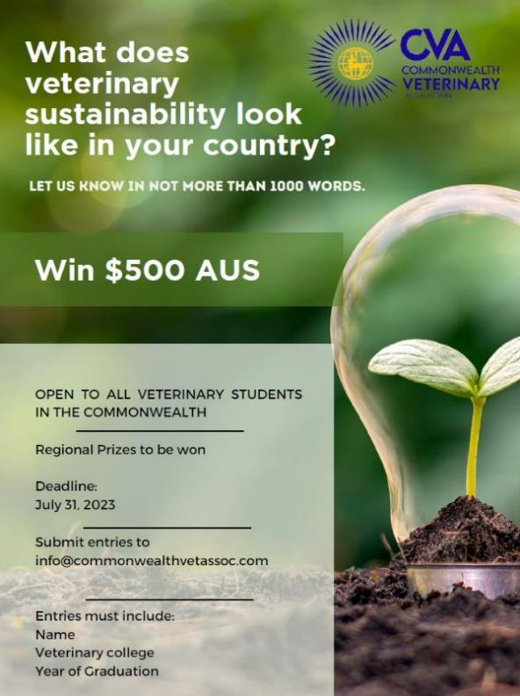
Competitions
CVA essay competition
CVA photo competition

Slide 18
Partnerships for Delivery
MoUs and Memberships
Other Collaborations
World Veterinary Association
Federation of Asian Veterinary Associations
International Veterinary Students Association
KVAFSU Rabies Laboratory
World Organisation for Animal Health (OIE)
University of Edinburgh
Murdoch University
Vets Beyond Borders
Vet Sustain
The Donkey Sanctuary, UK
Secretariat of the Pacific Community
The Brooke, UK
World Continuing Education Alliance
World Small Animal Veterinary Association
Vets for Climate Action
SPANA
Varsha

Slide 19
Planning for the next 50 years
CVA is working to improve communications (new website, monthly e-newsletters, new communications coordinator, social media).
Securing partnerships and attracting new collaborators.
Improve our funding security.

Slide 20
THANK YOU FOR YOUR ATTENTION

